Slide 1
ICS 168 Sprint 1
By: ScrumInvaders
Andrew Chau
Elaine Chieng
Tiffany Lam
Jessica Lim
Monami Yang

Slide 2
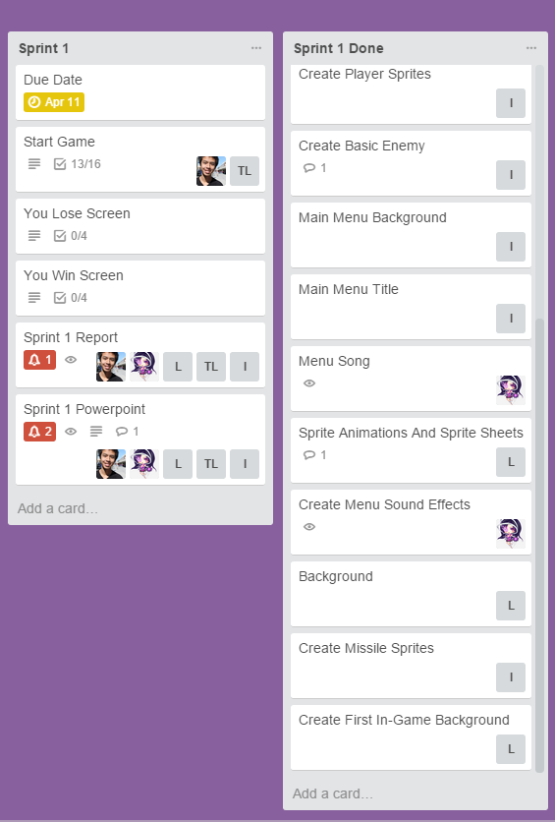
Roles
Programmers:
Andrew Chau
Tiffany Lam
Artists:
Elaine Chieng
Monami Yang
Music/Sound Effects:
Jessica Lim
Design:
Andrew Chau
Elaine Chieng
Jessica Lim
Monami Yang
Tiffany Lam
Manager:
Andrew Chau

Slide 3






Art and Music
Sprites:
more colorful and vibrant pixels
minimal animation
evolving player and enemies
Space background:
Intended to scroll as game runs
Music:
8 bit style music
Created in FamiTracker

Slide 4
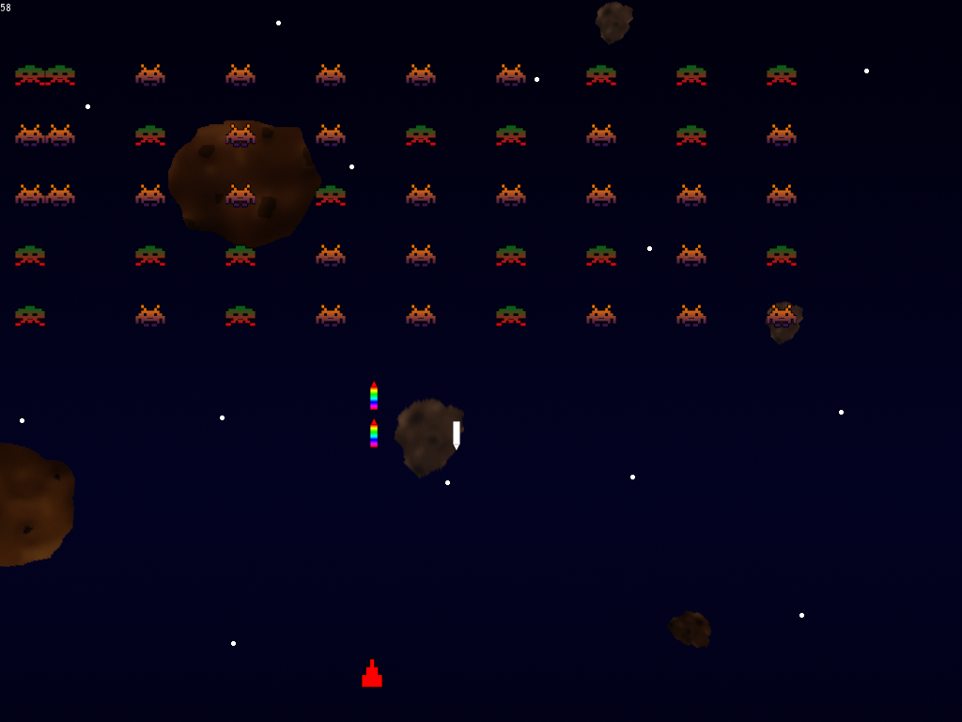
Game Design and Programming
Enemies
Snaking enemy movement (or randomized)
Each worth 100 points
Shoots randomly
Art generated randomly
Player(s)
Limited Ammo
Fire Delay
Score
Lives

